Slide 1


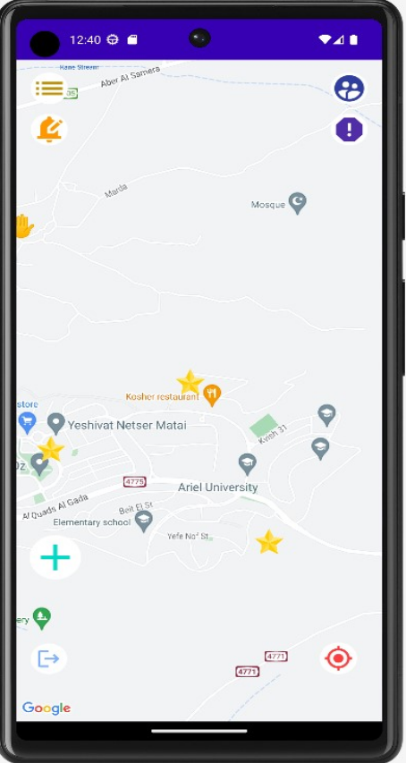
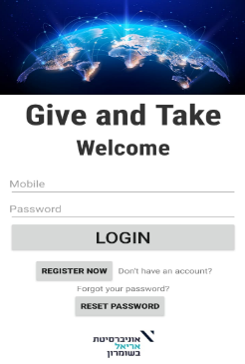


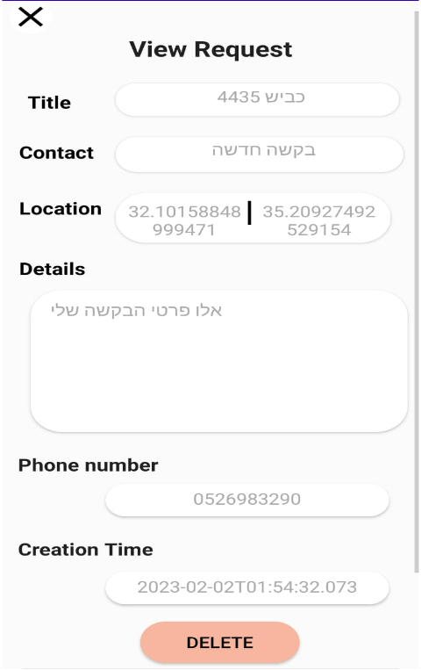

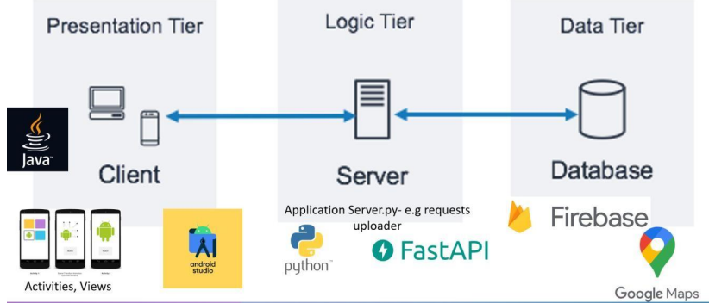
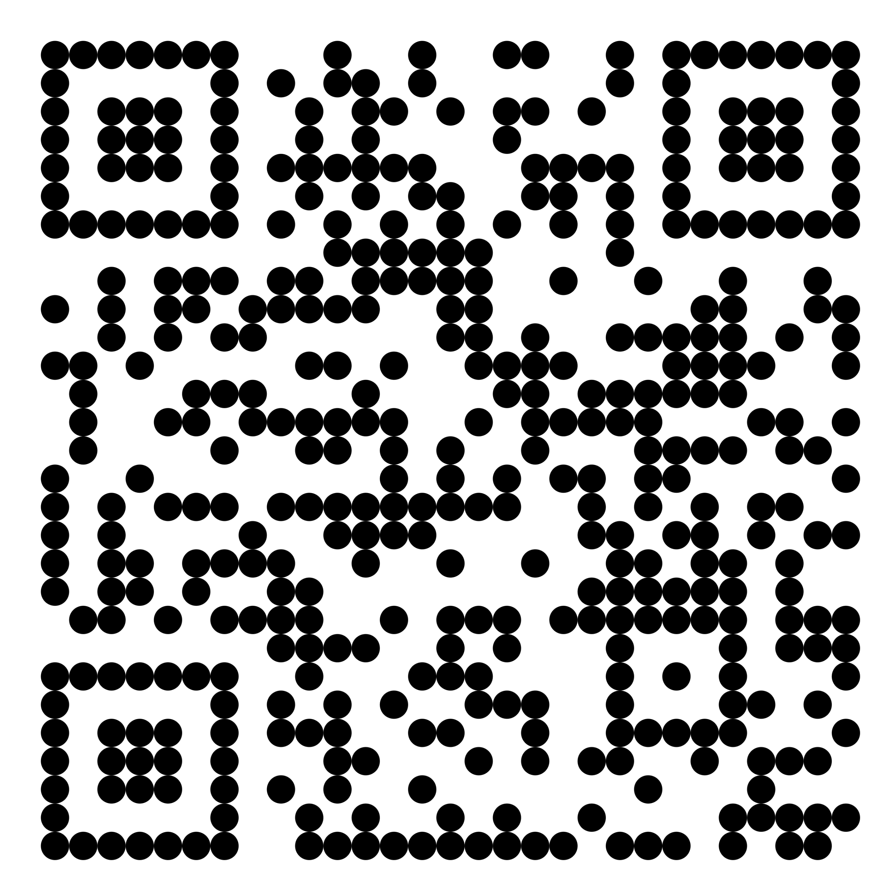
GIVE AND TAKE INFORMATION SYSTEM POSTER Group ID: 40
Developer: Shavit Luzon | Supervisor: Saed Asaly | Computer Science and Mathematics Final Project
INTRODUCTION
IMAGES
METHODOLOGY
FUNCTIONALITIES
IN-APP
The platform offers the following key functionalities:
Give and Take is an app designed to fulfill location-based needs and connect individuals seeking specific assistance or resources. Whether it's finding a study partner in the university library to tackle a challenging math problem, preparing for a sociology test, or locating volunteers to support the elderly near your campus.
Integrating Google Maps as a map service and utilizing Firebase Real Time database for efficient data storage, to develop a dedicated system specifically designed for Ariel University students and staff. Through this system, users will have the ability to mark and share events on a collaborative map.
Users can create and delete their own requests.
User registration and login with securely stored details.
A reliable, real-time, and interactive map shared among users.
Seamless communication between application users.
Requests are displayed on the map with dedicated icons.
"Locate me" option to pinpoint the user's current location on the map.
Notifications of new requests or events based on user preferences and within a selected radius of live or pre-determined locations. ADMIN PRIVILLIAGES:
Ability to block users and delete requests.
Option to add events with special icons.
Access to users' lists and users' requests lists. SECURITY & SAFETY:
Two-factor authentication for enhanced user protection.
User registration requires verification of the university email.
Phone number verification is conducted through SMS codes to ensure user authenticity.
IMPLEMENTATION
Java Android components for the app's functionality.
HTML and CSS for the client-side user interface.
Cloud-based database for data management.
Python server API for handling server-side operations.
Seamless integration of the map service.
Activation of the GPS sensor to ensure accurate location tracking.
PROJECT GOAL
To create a robust platform that facilitates seamless connections and resource sharing within local communities. By leveraging location-based filtering, our aim is to provide users with a convenient and efficient means to find and offer assistance, exchange resources and engage in reciprocal acts of kindness.
SYSTEM DESIGN
The system is developed using the MVC (Model-View-Controller) pattern for Android development and follows a 3-Tier Architecture approach.
SYSTEM CONSIDERATIONS
Real-time browsing and storage of requests.
Visualization of location information.
Ensuring the system maintains an exclusive and secure environment.
Facilitating communication between users.
Provision of administrative user roles to manage the app.
CONTACT INFO
luzonshavit00@gmail.com
+972 52 69 83 290
GitHub repo QR:

